Slide 1
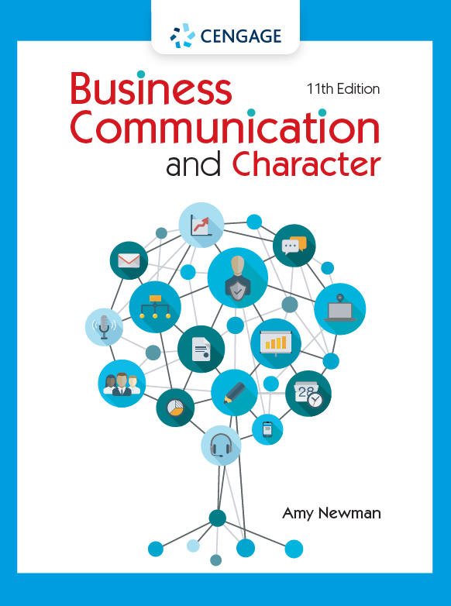
Employment Communication:
Making a Hiring Decision
© 2022 Cengage

Slide 2
About the Simulation
Learning Objectives
Materials
Evaluate employment communication against given job requirements
Apply interviewing skills as a company recruiter OR practice interviewing skills as a job applicant
Participate in a decision-making meeting
Communicate positive and negative hiring decisions
Job description
Cover letters and resumes from five candidates
Voicemails from three candidates
Interviewer’s Guide
Hiring Decision Matrix
View materials at amynewman.com/bankonme

Slide 3
Exercise 1: Selecting Candidates to Interview
Process
Criteria
Review candidate materials
Complete the Hiring Decision Matrix
Discuss candidates’ strengths and areas for improvement
Identify top candidates
Finance Coursework
Finance Experience
Leadership Experience
Degree and GPA
Communication Skills
Attention to Detail
Proficiency in Excel
Spanish Language

Slide 4
Exercise 2: Interviewing Candidates
Situation or Task: What brief context is important for the interviewer?
Action: How did you handle the situation? What did you do?
Result: How did the situation turn out? How can you prove that your action was appropriate in the situation?

Slide 5
Exercise 3: Making a Hiring Decision
Complete the Hiring Decision Matrix
Prepare to support assessment with specific examples
Rank order candidates
Interviewers come to consensus
Observers provide feedback
Discuss in groups (Observers take notes)

Slide 6
Exercise 4: Communicating the Decision
Good News: Hired!
What’s the best communication medium for the message?
Bad News: Not Hired
What information will you provide?
What’s the best communication medium for the message?
What information will you provide?

